Slide 1

AAS-Webclient
SE
Repräsentation von Digitalen Zwillingen per AASX-Server
INF21C

Slide 2

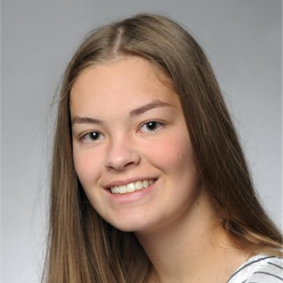


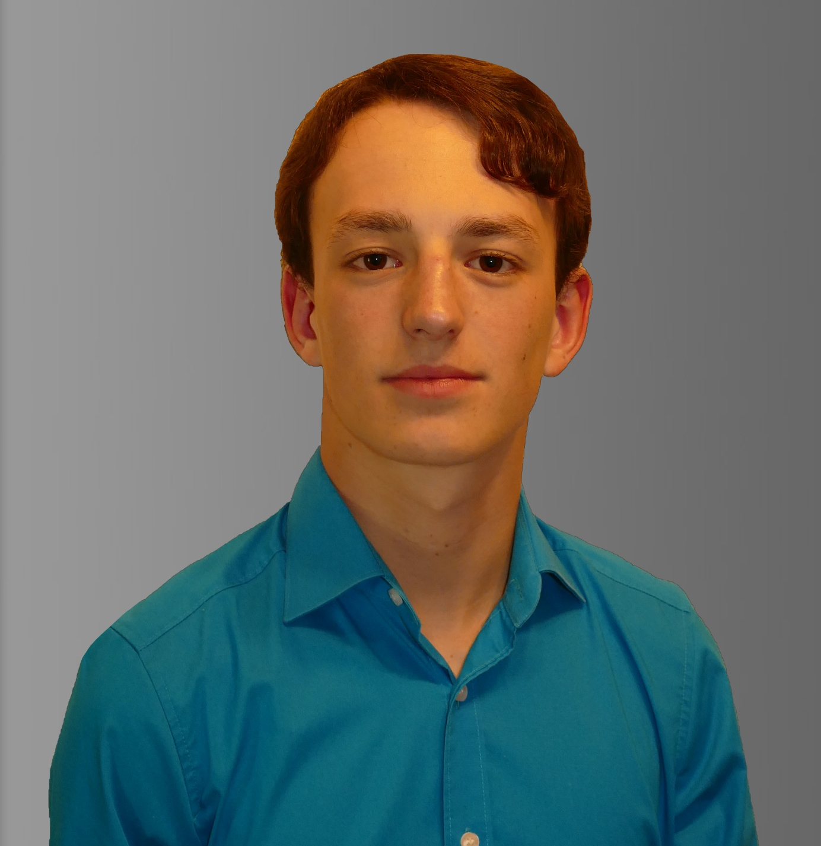

Das Team
Samara Dominik
Project Leader
inf21001@lehre.dhbw-stuttgart.de
1047506
Anja Niedermeier
Test Manager
inf21097@lehre.dhbw-stuttgart.de
5697407
Martin Rittmann
Product Manager
inf21157@lehre.dhbw-stuttgart.de
8461817
Severin Helms
Developer
inf21047@lehre.dhbw-stuttgart.de
3391129
Marcel Hintze
System Architect
inf21056@lehre.dhbw-stuttgart.de
3932152
Tom Engelmann
Technical Documentation
inf21010@lehre.dhbw-stuttgart.de
1594643

Slide 3
Project Overview
Realization of a user-friendly frontend application for the human-centric representation of AAS servers and their contents (digital twins)

Slide 4
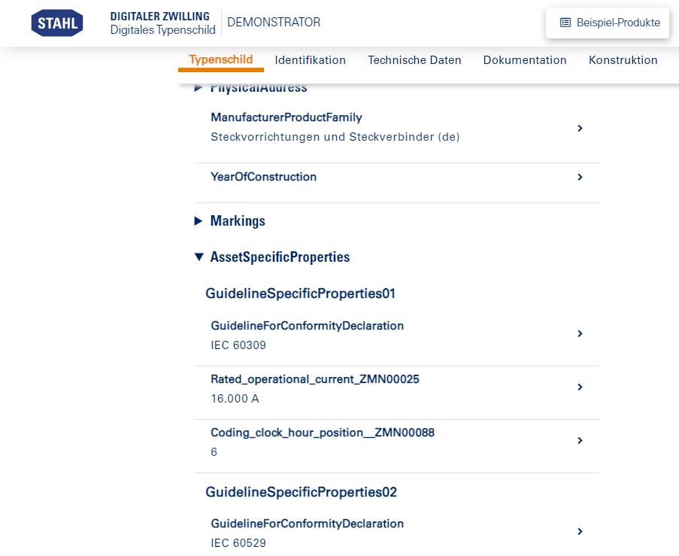
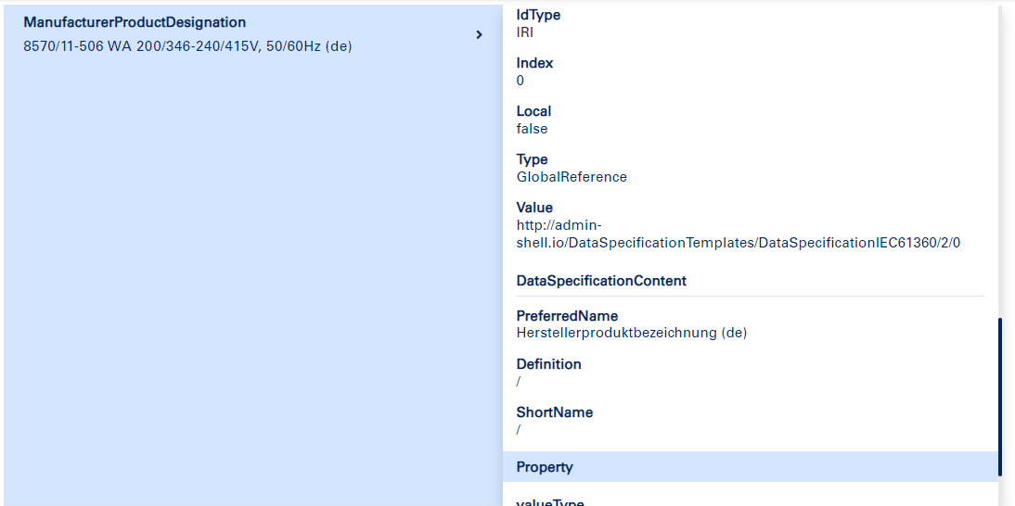
Project Overview

Slide 5
Digital Twin
Definition:
Digital twins are digital representations of material or immaterial things from the real world. It is irrelevant whether the counterpart already exists in the real world or will only exist in the future.
vgl. https://gi.de/informatiklexikon/digitaler-zwilling
Einsatzbereiche:
Production planning and optimization
Digitization of certification procedures (e.g. in aerospace engineering)
Comprehensive information exchange of workpieces

Slide 6
Asset Administration Shell
Definition:
A concept of the plattform industry 4.0 to standardize the implementation of "Industry 4.0-components", which consists of digital twins in the form of asset administration shells (AAS) and the associated physical object (the
so-called asset).
vgl. TINF21C_VE07_DigitalTwin_AAS_Nameplat_MR.pdf
Use:
provides manufacturer-independent combinable digital twins that can be accessed via standardized interfaces
standardizes communication interfaces in a network
provides the interface to the physical asset, as well as a data memory for information about the asset

Slide 7
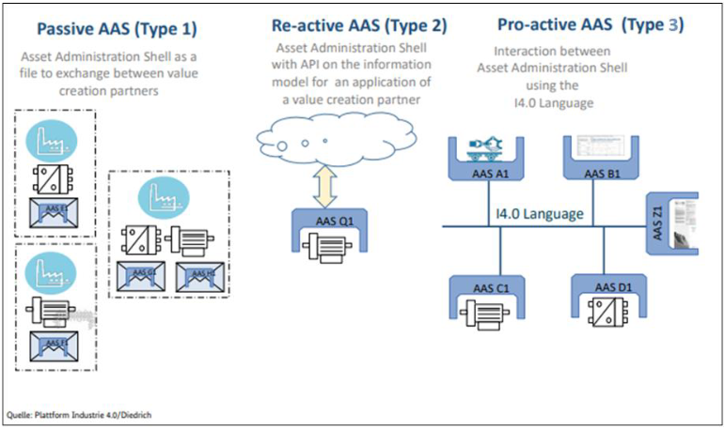
Asset Administration Shell
vgl. TINF21C_VE07_DigitalTwin_AAS_Nameplat_MR.pdf

Slide 8
Asset Administration Shell
Asset:
physical or logical object owned by or under the custodial duties of an organization, having either a perceived
or actual value to the organization
Source: SPECIFICATION - Details of the Asset Administration Shell

Slide 9
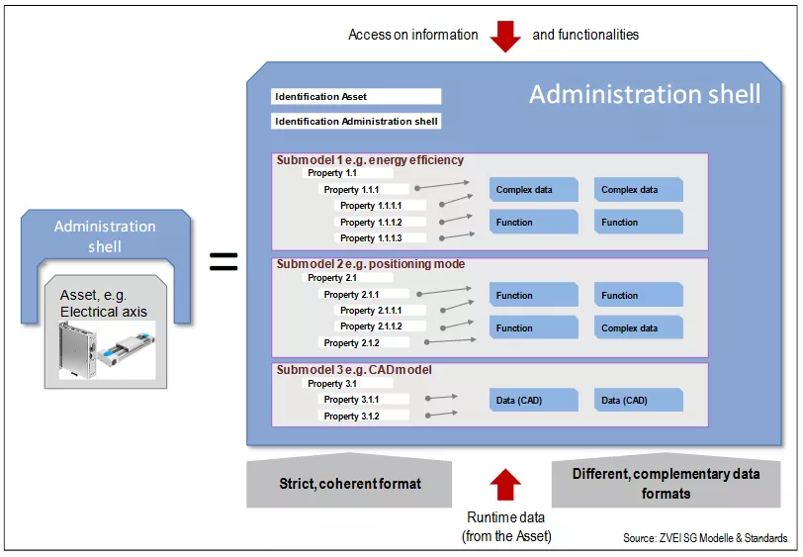
Asset Administration Shell
Asset Administration Shell
standardized digital representation of the asset
describes technical functionalities
provides digital twins, which are accessible via standardized Interfaces
different assets can have the same AAS
holds all relevant information about an asset

Slide 10







Functional Requirements
Adding AASX-Servers via URL (including Server-Validation)
Removing AASX-Servers
Display of all digital twins (assets) of a selected server
Opening the detail view for any asset
Searching for a specific asset by serial number or name
Filtering of the displayed assets by properties (manufacturer, year, etc)
Error handling for unpredicted incidents

Slide 11
Non-functional Requirements
Intuitiveness
Reliability
Efficiency
User-friendly and human-centric presentation
Low error rate and crashes
Time and resource-saving processes
No need for training or prior experience of the user
Self-explanatory features and layout
Reliable presentation of information

Slide 12
Business Case
Goal:
Realization of a user-friendly frontend application for the human-centric representation of AAS servers and their contents (digital twins)
Return on Investment:
Long-term simplification and thus acceleration of the work with AAS
Time Scope:
Analysis & Design
Implementation
Risks:
Financial Risks
Return Risk
Expenses:
Wages + Work packages + Additional costs = ~105k
Offer:
Expenses + 25% profit margin = ~131.3k

Slide 13
Tools
Internal communication channels:
WhatsApp
direct, immediate exchange
MS Teams
Exchange of important specifications, information and documents
Meetings
Preparation of documents: MS Office tools (Word, PowerPoint, Excel)
Publication: GitHub Repository

Slide 14
Approach- 1st Phase
Appointed experts in main areas according to skills and interests
Project leading (Samara Dominik)
Product management (Martin Rittmann)
Development (Marcel Hintze, Severin Helms)
Testing (Anja Niedermeier, Tom Engelmann)
Documentation (Tom Engelmann)
Experts worked mainly without influence from other team members

Slide 15
Approach- 1st Phase
Appointed experts in main areas, but provided the possibility for "responsibility switches" to equalize the workload
Project leading (Samara Dominik)
Product management (Martin Rittmann)
Development (Marcel Hintze, Severin Helms, Anja Niedermaier, Martin Rittmann, Tom Engelmann, Samara Dominik)
Testing (Anja Niedermeier, Tom Engelmann, Martin Rittmann, Samara Dominik)
Documentation (Tom Engelmann)

Slide 16
Approach- 1st Phase
Clearly separated work packages:
Build up on each other, but shifted in time
One team member passes on their finalized work package to another team member, so that this person can use it as requirements for their own work package
Very time efficient, since this made many meetings redundant and just acquired short meetings between the concerned team members

Slide 17
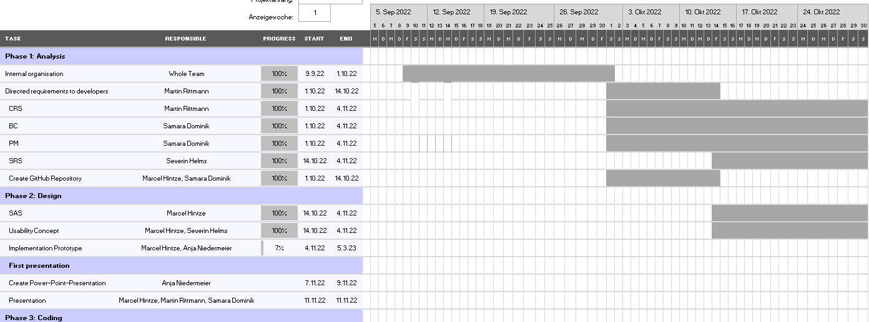
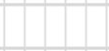
Approach- 1st Phase

Slide 18
Approach- 2nd Phase
Remains
Experts in main areas
New
2 big main areas (Development, Testing)
Within these areas a clear separation will not be possible, thus more communication between members will be necessary
Slightly modified SCRUM-Modell

Slide 19
Approach- 2nd Phase
Scrum Master: Samara Dominik
Product Owner:
Martin Rittmann
Development
Testing
Sprint
Documen-tation
Sprint review
Update product backlog
Sprint planning meeting
Sprint
Documen-tation
Sprint review
Update product backlog
Sprint planning meeting
Severin Helms,
Marcel Hintze
Anja Niedermeier,
Tom Engelmann
Anja Niedermeier, Tom Engelmann, Severin Helms, Marcel Hintze, Samara Dominik, Martin Rittmann

Slide 20
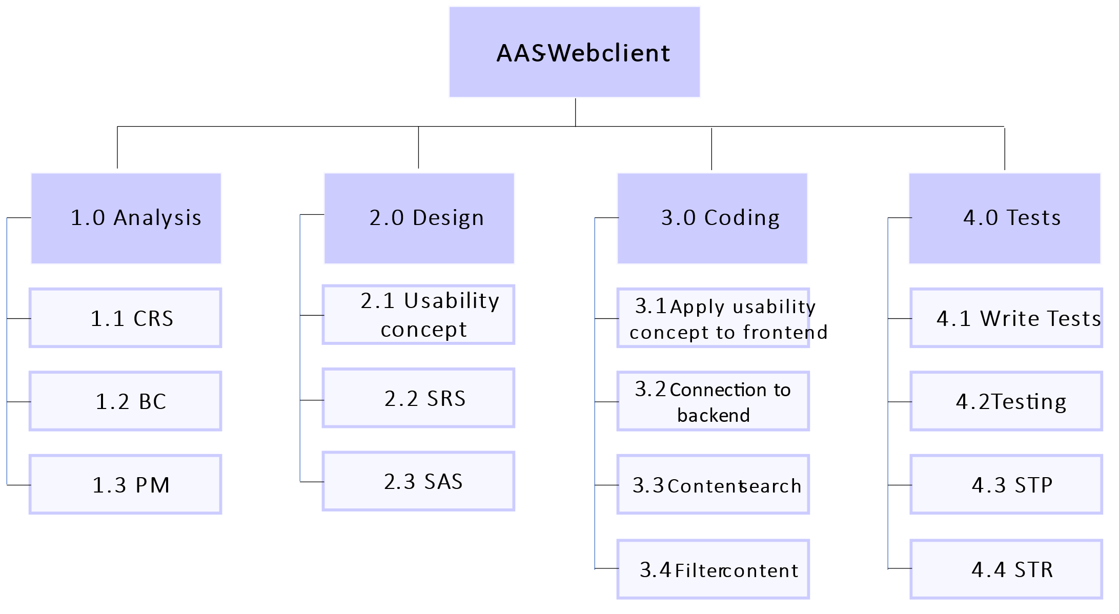
Modularization

Slide 21
Project plan- Risks
Personal risk
Planning risk
Extent of damage
Financial risk
Communication risk
Knowledge risk
Likelihood of occurence

Slide 22
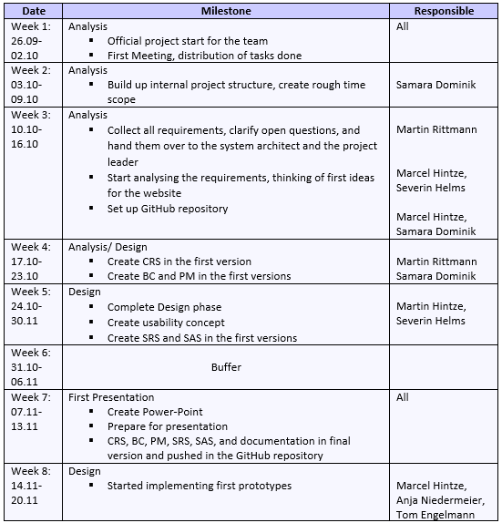
Project plan- Milestone Plan

Slide 23
Project plan- GANTT chart

Slide 24
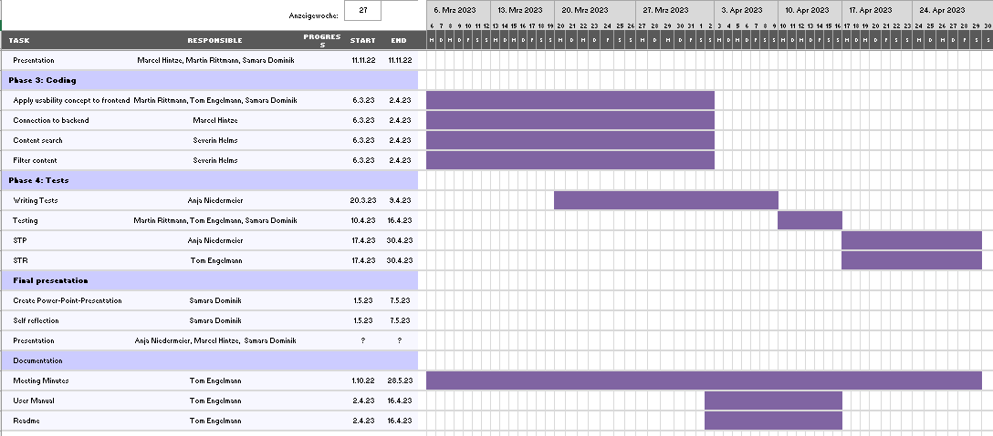
Project plan- GANTT chart

Slide 25
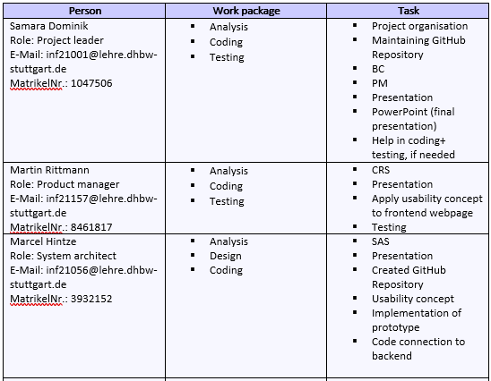
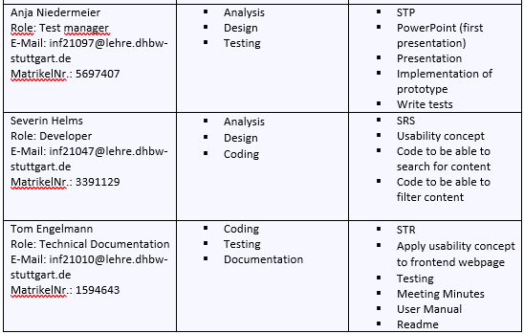
Project plan- List of operations

Slide 26
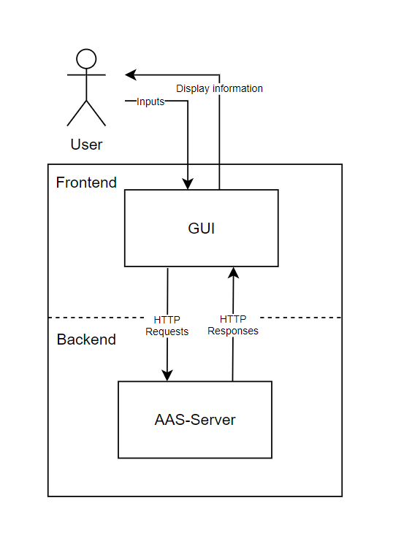
System Architecture

Slide 27
GUI – No Server Connection
AAS-WEBCLIENT
Server-URLL
Add Server
Filters:
Assets:
No contents available, connect Server to display Assets

Slide 28

GUI –Server connected
AAS-WEBCLIENT
Server: Server-URL
Delete Server
Filters:
Assets:
Search
Article name – Serial number
Open
Manufacturer
Year
Article name – Serial number
Open
Serialnumber
Article name – Serial number
Open
Article name – Serial number
Open
Article name – Serial number
Open
Article name – Serial number
Open

Slide 29


Technical Solutions
GUI
Application
Backend
Bootstrap as Frontend CSS- Framework
React as Javascript Library für UI Components
Server accessible via standardized REST API
(HTTP-Requests; JSON as response type)

